Slide 1
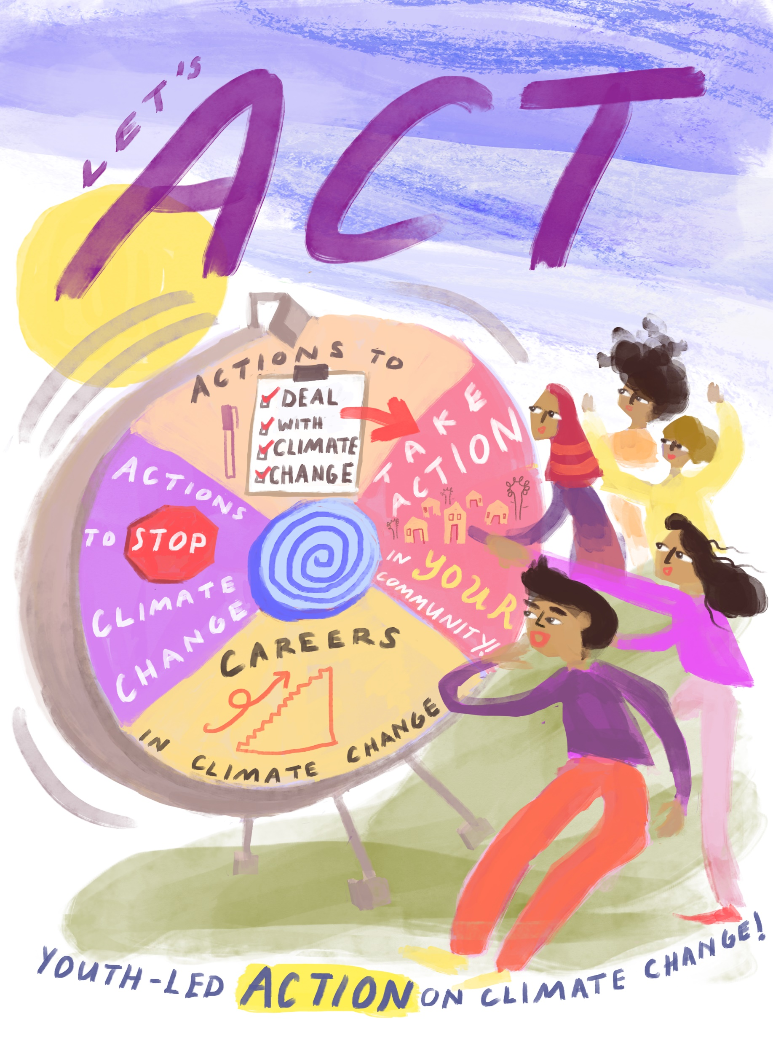
Youth Unit: Let’s ACT!
Youth action on climate change
Notes:
[Note: click 'View' → 'Slide Master' to insert the title of the module in the footnote]

Slide 3
Overview
Introduction
Action to STOP climate change getting worse (mitigation)
Action to DEAL WITH climate change impacts (adaptation)
Differentiated impacts
What can you do? Take climate action in your community
What can you do? Careers in climate change

Slide 4
Introduction

Slide 5
Two Types of Action
1. Actions to STOP climate change from getting worse.
This is called Climate Change Mitigation (CCM)
The Red Cross Red Crescent Movement’s work on climate change focuses mainly on Climate Change Adaptation, striving to reduce the impacts of climate change for the most vulnerable people
However as an active youth, staff or volunteer, it is also important to understand Climate Change Mitigation
2. Actions to DEAL WITH the impacts of climate change.
This is called Climate Change Adaptation (CCA)

Slide 6
Actions to STOP climate change from getting worse
CLIMATE CHANGE MITIGATION

Slide 7
Climate Change Mitigation (CCM)
We can act to STOP climate change from getting worse
This means reducing human activities that release greenhouse gases
This is called Climate Change Mitigation
CCM example: Countries stop using fossil fuels which release greenhouse gases, such as coal & oil in factories, industry and transport. Instead they develop & use renewable energy sources such as solar, wind & hydropower.

Slide 8
Global action needed to STOP climate change from getting worse
To be effective in stopping climate change, countries across the world must reduce the amount of greenhouse gas they release
In 2015, under the Paris Agreement, almost all countries pledged to take action to reduce their greenhouse gas emissions
The actions taken in upcoming years will determine the amount of future warming and the extent of climate change

Slide 9
Small changes as the start of bigger change
Use less heat, hot water and A/C
Reduce, Reuse, Recycle
Drive less & drive smart
Use energy efficient products e.g. lightbulbs
Plant trees
Encourage others to save energy
No one can stop climate change on their own, but small changes can be the start of bigger change
Here are some simple actions we all can take:

Slide 10
Actions to DEAL WITH the impacts of climate change
CLIMATE CHANGE ADAPTATION

Slide 11
Climate Change Adaptation (CCA)
We can take action to DEAL WITH climate change impacts
CCA is the main focus of the RCRC’s work on climate change
By adjusting and adapting both the natural and human environment we can be better prepared for climate change impacts.
This is called Climate Change Adaptation
Adaptation actions are very important today because we are already experiencing climate change impacts across the world
Adaptation is also important for the future because we know that climate change will continue

Slide 12
Win-Win Climate Action
Win-Win climate change adaptations are actions that DEAL WITH climate change impacts whilst also taking action to STOP climate change
Ideally, all actions should aim to be win-win
Win-Win CCA example:
Youth clear drains of rubbish in their community to reduce the risk of flooding (dealing with climate change / CCA), by providing rubbish bins and encouraging recycling (helping to stop climate change / CCM)

Slide 13
Climate change adaptation & differentiated impacts

Slide 14
Climate change impacts
Climate Change
Top tip: Play ‘Map the Hazard’ and the ‘Systems Game’ from Y-Adapt to help you think through your answer!
Think about the impacts of extreme weather events & hazards in your community
Do the extreme weather events & hazards impact everyone in the same way, or in different ways?

Slide 15
Differentiated impacts
Extreme weather & hazards impact different people in different ways
We call this differentiated impacts
Blocked transportation:
Children & youth can’t get to school. Adults can’t get to work
Failed crops:
Farmers suffer a loss of income
Vector and water-borne diseases increase i.e. malaria & diarrhoea:
Children and elderly people are more vulnerable
Let’s think about extreme weather events impacting a peri-urban community:
Notes:
Blocked transportation: children & youth can’t get to school; adults can’t get to work
Reduced incomes: school fees are unaffordable for poorer families
Failed crops: lost incomes for farmers
Less food and water: growing young children very effected
Vector and water-borne diseases proliferate i.e. malaria & diarrhoea: children and elderly are more vulnerable
Reduced livelihood opportunities: forced migration for youth

Slide 16
Differentiated impacts, youth & gender
During disasters, sometimes girls take on women’s roles & boys take on men’s roles
This can increase or decrease the amount girls or boys are at risk from the disaster
This can cause differentiated impacts between girls & boys
Age, race, class & ability also shape how girls & boys are impacted³
Top Tip! Learn how we can address differentiated impacts and gender in the ‘Let’s Engage’ section
Think about your community. Are there some roles & responsibilities that women typically do, and some that men typically do?

Slide 17
Differentiated impacts & climate change adaptation
When planning action it is important to consider differentiated impacts, so that it responds to vulnerabilities across your community
Think about:
Factors that increase vulnerability of particular groups
Gendered roles & how these may affect vulnerability of boys, girls, non-binary youth & women
How your action responds to specific vulnerabilities
Don’t forget to!
Recognise abilities & knowledge of different groups, not just vulnerabilities
Engage & discuss with different groups in your community to better inform your CCA planning

Slide 18
Take climate change adaptation action in your community!

Slide 19
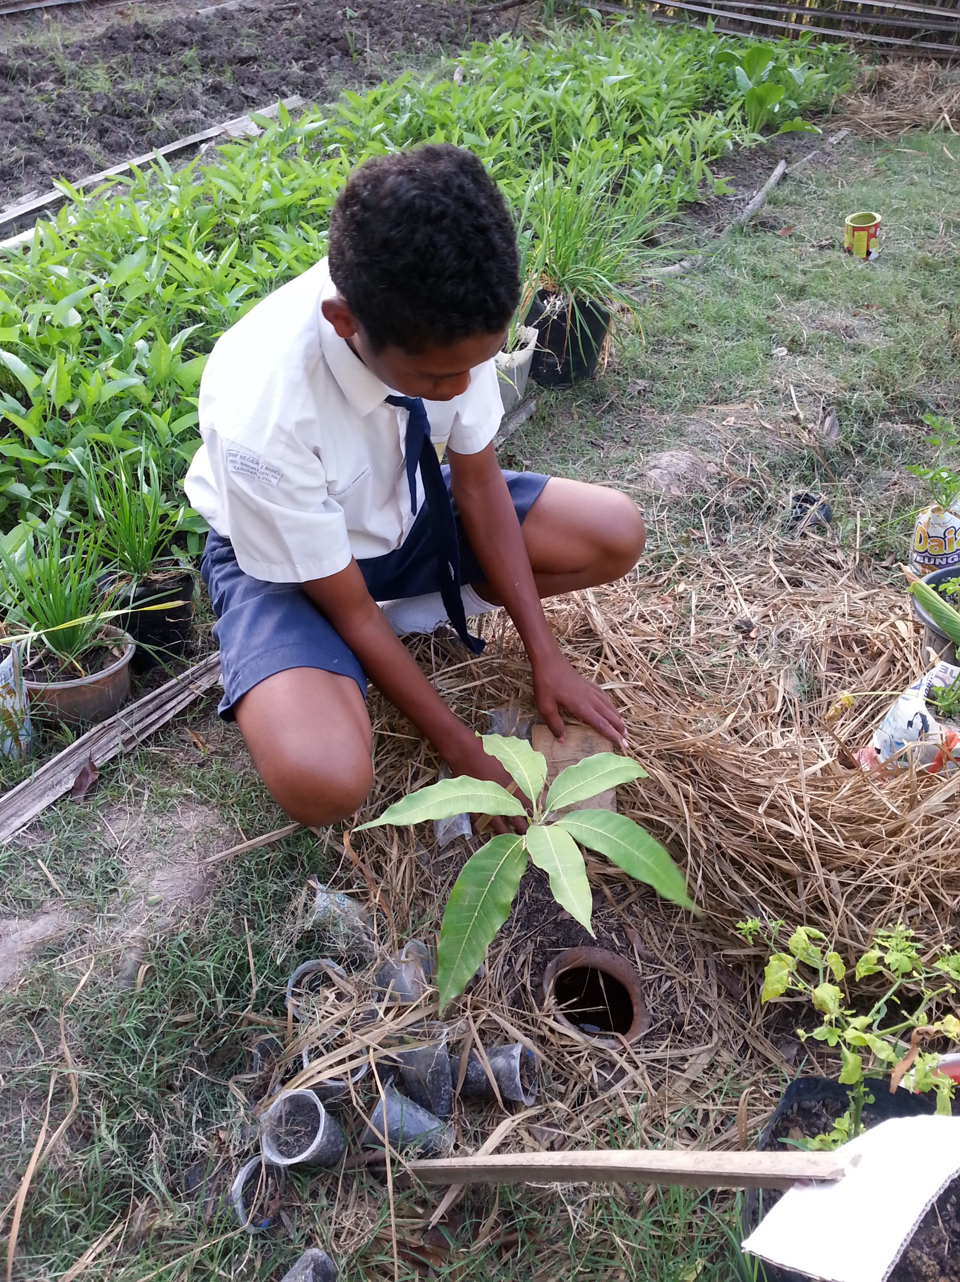
Youth-led CCA: Y-Adapt actions
Look at the Y-Adapt Adaptation Cards for examples of real life youth-led CCA around the world [In ‘RCRC experience’]
Could you use these ideas and take action in your community?
Youth in Indonesia installing a slow drip irrigation system

Slide 20
Youth led adaptation: real life examples See the Y-Adapt Presentation in Let’s Learn to find out more

Slide 21
Dengue Campaign led by RCY, Santa Rossa Guatemala: Photo Diary, Y-Adapt Action Phase
2. Making a weekly plan of action
3. Proposing the dengue campaign to the local government
4. Official permission for the campaign
5. Discussing the campaign with the local clinic
6. Information & support from the local clinic
1. Planning meetings
7. Organising an event
8. Dengue campaign & presentation by RC Youth
9. Sharing the campaign on social media

Slide 22
Adaptation card of the dengue awareness campaign!
On completing the dengue campaign, the youth captured their CCA action in a Y-Adapt Adaptation Card
This will be shared online and used to inspire the next group of Y-Adapters and youth around the world!
A Y-Adapt youth holds up their Adaptation Card, capturing the steps they took in their community to adapt by raising awareness on dengue & climate change

Slide 23
What can you do? Careers in climate change

Slide 24
Interested in a climate change related career?
Climate change is interdisciplinary so there are many different pathways to a career in the sector
Start building relevant knowledge & experience as soon as possible
Network! Go to conferences and talks on relevant topics. Ask questions & engage with the speakers and audience
Education - enrol on a relevant masters and plan your thesis topic – use it as an opportunity to reach out to organisations
Volunteer in your community with environmental groups
Link with your local Red Cross Youth and get involved with Y-Adapt
Join or set up a youth club for climate change action

Slide 25
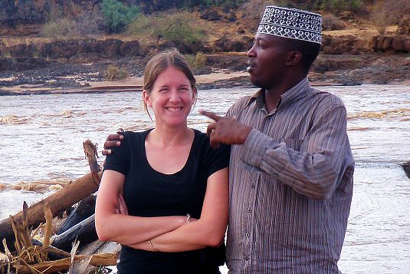
Climate Centre Junior Researchers
Keen to support the work of the RCRC Climate Centre?
Currently enrolled in a relevant masters programme?
Highly motivated to act on climate change?
Innovative, imaginative and an independent worker?
See our webpage for opportunities & how to apply
You could be a great fit for our
Junior Researcher’s Programme!
Yunos Anthony Kimathi shares experience with Junior Researcher Amy Quandt in Kenya

Slide 26
Take action & share your story!
Send a short
video of your action to kit@climatecentre.org & we’ll add it to our ‘Youth Unit’ to inspire others!
See ‘National Society experiences’ for ideas
Philippine Red Cross Youth Facilitators, La Union Branch, discuss how different extreme weather events & hazards impact their community and share their action plan to adapt their community (Y-Adapt)
Notes:
Send your experience to Rudram@climatecentre.org and we can add it to our ‘Youth Unit’ resources to inspire others! See ‘National Society experiences’ for ideas

Slide 27
References
¹ Shreve, C. and Fordham, M. (2018) Child-Centred Risk Reduction Research into Practice Brief: Gender and Disasters: Considering Children. Global Alliance for Disaster Risk Reducation & Resilience in the Education Sector
Youth Vulnerabilities and Adaptation Exploring the Impact of Macro-Level Shocks on Youth: 3F Crisis and Climate Change in Ghana, Mozambique and Vietnam (2011) Pereznieto, P. Online at: https://www.odi.org/sites/odi.org.uk/files/odi-assets/publications-opinion-files/7175.pdf
Graphics
Rebeka Ryvola
Photograph accreditations
Brigitte Rudram
Guatemala Red Cross ]
Image accreditations
The Noun Project
Y-Adapt images

